Slide 1


Eze Chidera Bright
18/01/2023

Slide 2
Outline
Executive Summary
Introduction
Methodology
Results
Conclusion
Appendix

Slide 3
Executive Summary
Summary of the methodology used in the course are
Data collection
Data wrangling
Data visualization
EDA with SQL
Interactive map with Folium
Building of dashboard with Plotly Dash
Predictive analysis
Summary of all results
This course has enabled me to have a good understanding of data science methodology as listed above that I can apply in any field I find myself in the future.
EDA results
Interactive analysis
Predictive analysis

Slide 4
Introduction
Project background and context
SpaceX advertises Falcon 9 rocket launches on its websites, with a cost of 62 million dollars other providers cost upward of 165 million dollars each, much of the savings is because SpaceX can reuse the first stage.
Problems you want to find answers
The project task is to predict if the first stage of the SpaceX falcon 9 rocket will land successfully

Slide 5

Section 1

Slide 6
Methodology
Executive Summary
Data collection methodology:
The data used in this course were gathered using the following data collection methodology web scraping from Wikipedia and downloading the dataset using SpaceX Rest APIs
Perform data wrangling
The data were processed in this course by performing data wrangling such as One hot Encoding data fields and data cleaning of null values and irrelevant column
Perform exploratory data analysis (EDA) using visualization and SQL
Perform interactive visual analytics using Folium and Plotly Dash
Perform predictive analysis using classification models
To perform predictive analysis using classification models you have to do data preparation, model selection, model training, model tuning, model evaluation, and model interpretation.
LR, KNN, SVM, DT models have been built and evaluated for the best classifier

Slide 7

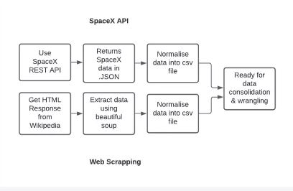
Data Collection
Describe how data sets were collected.
The data used in this course were gathered using the following data collection methodology web scraping Wikipedia using BeautifulSoup and downloading the dataset using SpaceX REST API.
SpaceX launch data that is gathered from the SpaceX REST API
The SpaceX REST API endpoints, or URL, starts with api.spacexdata.com/v4/.
Place your flowchart of SpaceX API calls here

Slide 8
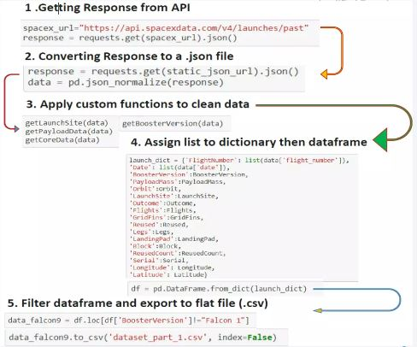
Data Collection – SpaceX API
Data collection with SpaceX REST calls using key phrases and flowcharts
https://github.com/dera1992/assignment/blob/main/jupyter-labs-spacex-data-collection-api%20.ipynb

Slide 9
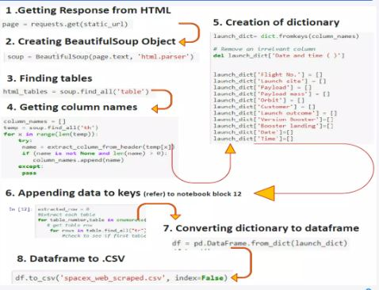
Data Collection - Scraping
Web scraping process using key phrases and flowcharts
https://github.com/dera1992/assignment/blob/main/jupyter-labs-webscraping%20(1).ipynb
Place your flowchart of web scraping here

Slide 10
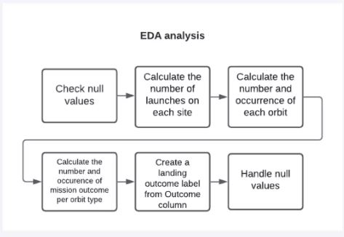
Data Wrangling
Attached is the data wrangling process.
https://github.com/dera1992/assignment/blob/main/labs-jupyter-spacex-data_wrangling_jupyterlite.jupyterlite.ipynb

Slide 11
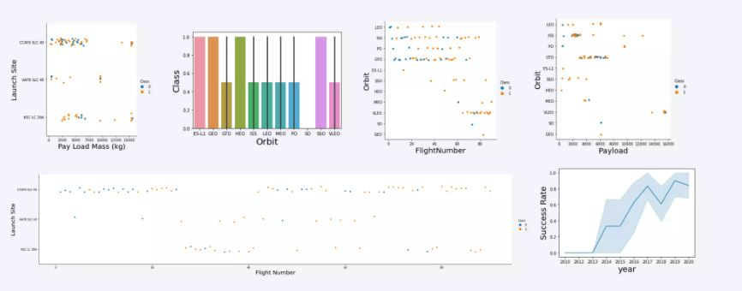
EDA with Data Visualization
The reason why the charts were ploted is to find the relationships that exists among the variable that will enable us answer the required questions
https://github.com/dera1992/assignment/blob/main/jupyter-labs-eda-dataviz.ipynb.jupyterlite.ipynb

Slide 12
EDA with SQL
The SQL queries you performed are
Display the names of the unique launch sites in the space mission
Display 5 records where launch sites begin with the string ‘CCA
Display the total payload mass carried by boosters launched by NASA (CRS)
Display average payload mass carried by booster version F9 v1.1
List the date when the first succesful landing outcome in ground pad was acheived.
List the names of the boosters which have success in drone ship and have payload mass greater than 4000 but less than 6000
List the total number of successful and failure mission outcomes
List the names of the booster_versions which have carried the maximum payload mass. Use a subquery
List the records which will display the month names, failure landing_outcomes in drone ship ,booster versions, launch_site for the months in year 2015
https://github.com/dera1992/assignment/blob/main/jupyter-labs-eda-sql-coursera_sqllite.ipynb

Slide 13
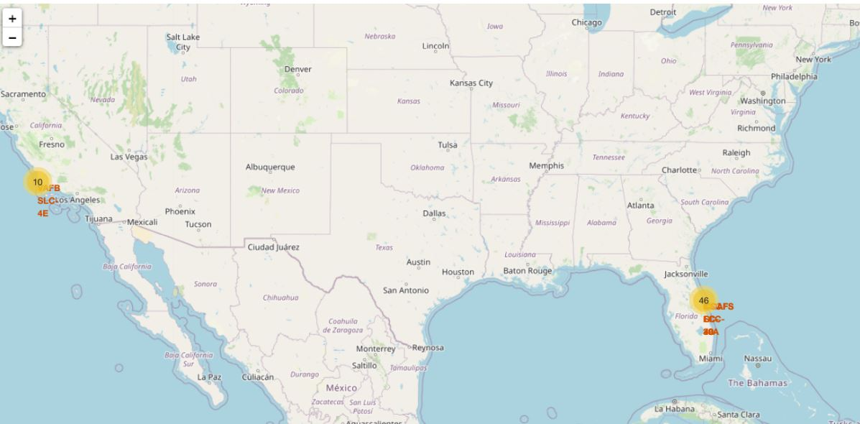
Build an Interactive Map with Folium
The reason for adding the object is to easily identify which launch sites have relatively high success rates.
https://github.com/dera1992/assignment/blob/main/lab_jupyter_launch_site_locationInteractive%20Map%20with%20Folium.ipynb

Slide 14
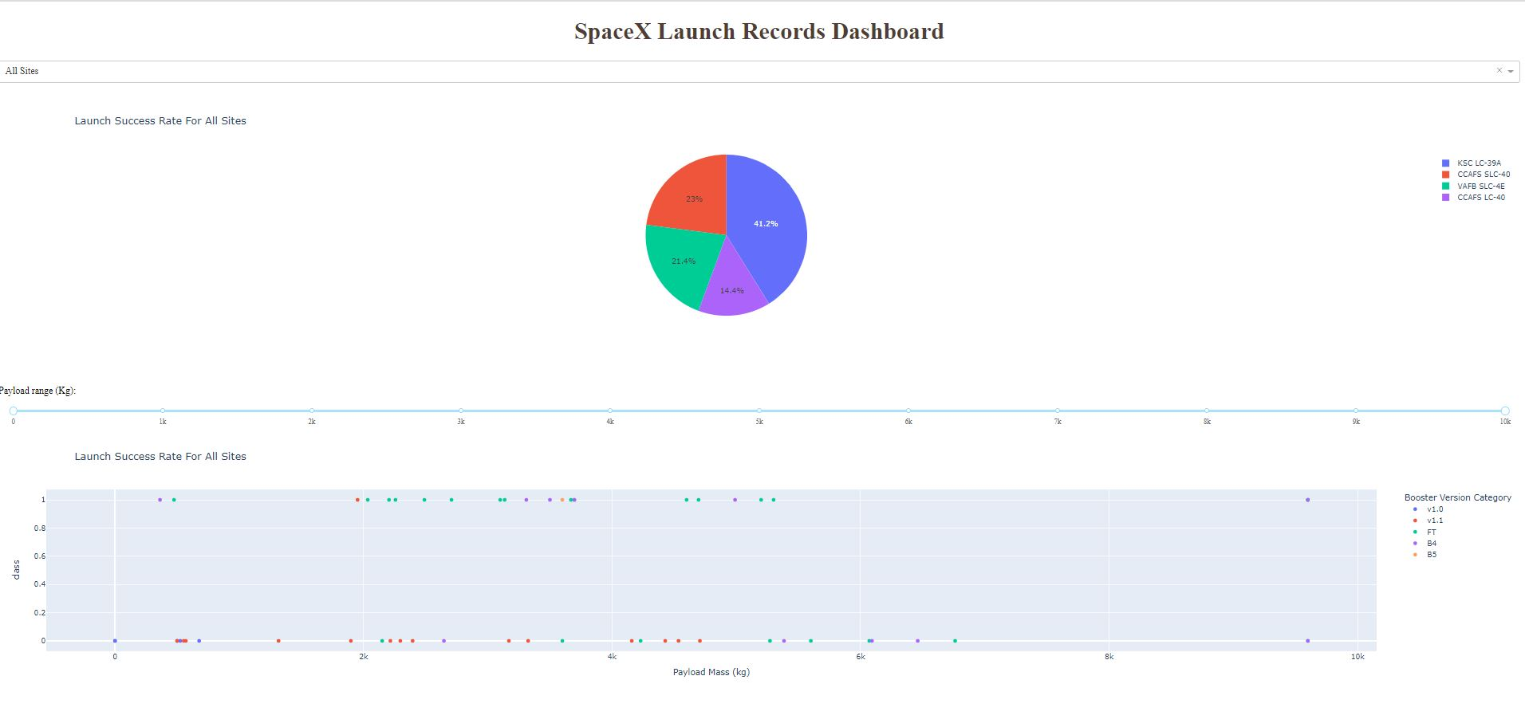
Build a Dashboard with Plotly Dash
Summarize what plots/graphs and interactions you have added to a dashboard
https://github.com/dera1992/assignment/blob/main/spacex_dash_app.py

Slide 15
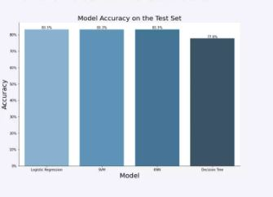
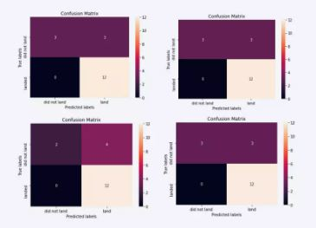
Predictive Analysis (Classification)
The SVM, KNN, and Logistic Regression model achieved the highest accuracy at 83.3%, while the SVM performs the best in terms of Area Under the Curve at 0.958
https://github.com/dera1992/assignment/blob/main/SpaceX_Machine_Learning_Prediction_Part_5.jupyterlite.ipynb

Slide 16
Results
Low weighted payloads perform better than the heavier payloads.
The SVM, KNN AND Logistic Regression models are the best in terms of prediction accuracy for this dataset

Slide 17

Section 2

Slide 18
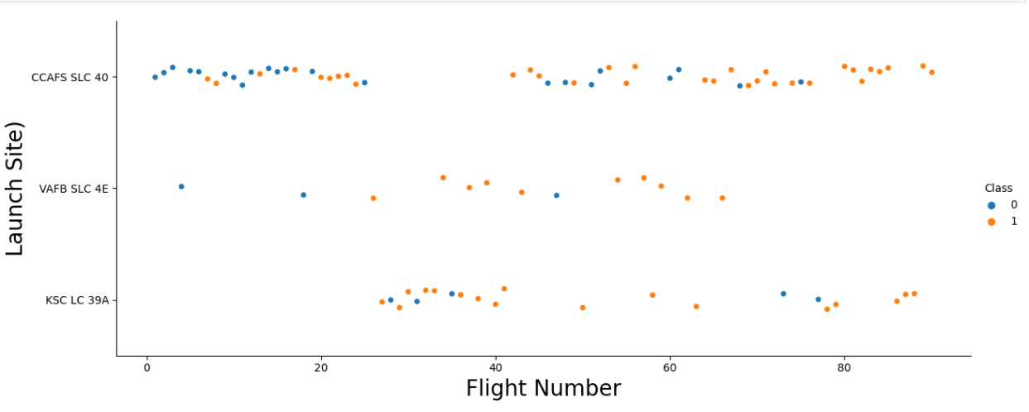
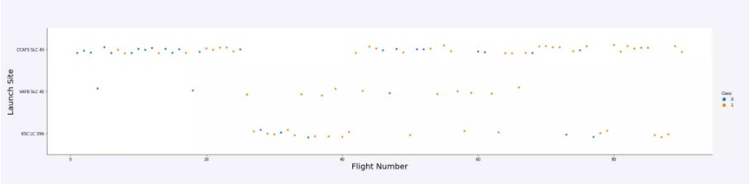
Flight Number vs. Launch Site
Launches from the site of CCAFS SLC40 are significantly higher than launches from other sites

Slide 19
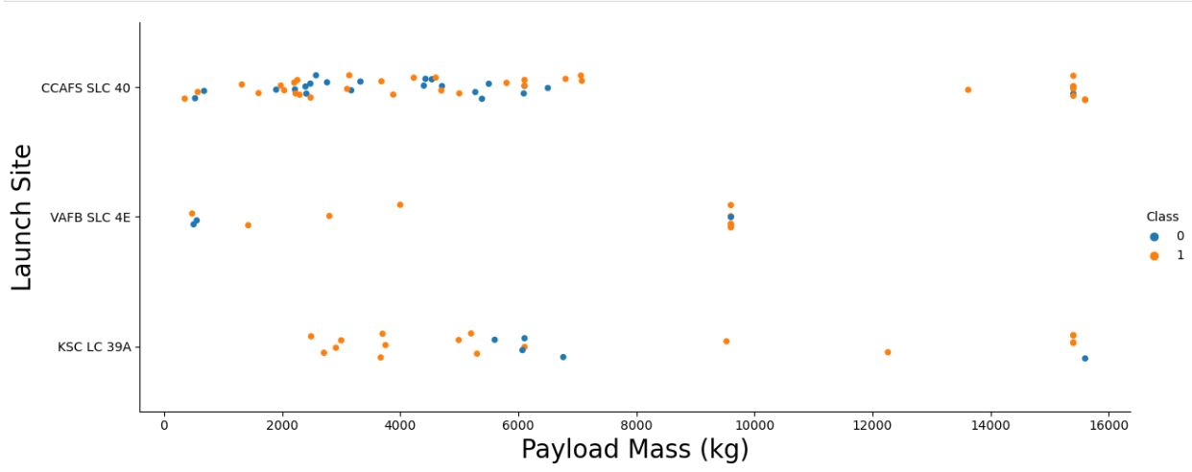
Payload vs. Launch Site
The majority of Ipay Loads with lower Mass have been launched from CCAFS SLC 40

Slide 20
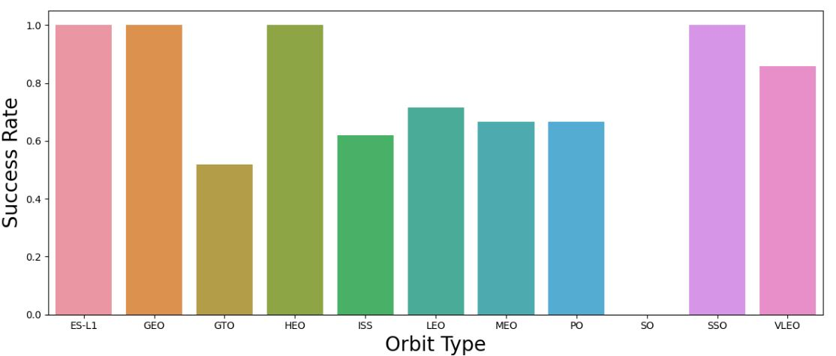
Success Rate vs. Orbit Type
The orbit tu=ypes of ES-L1, GEO, HEO, SSO are among the highest success rate

Slide 21
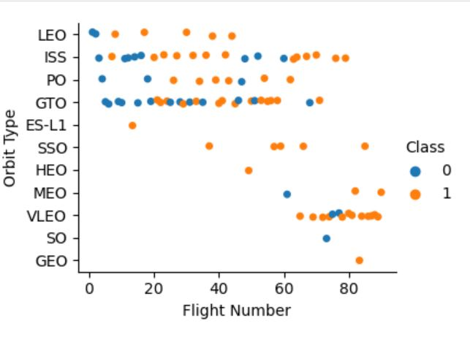
Flight Number vs. Orbit Type
A trend can be observed of shifting to VLEO launches in recent years

Slide 22
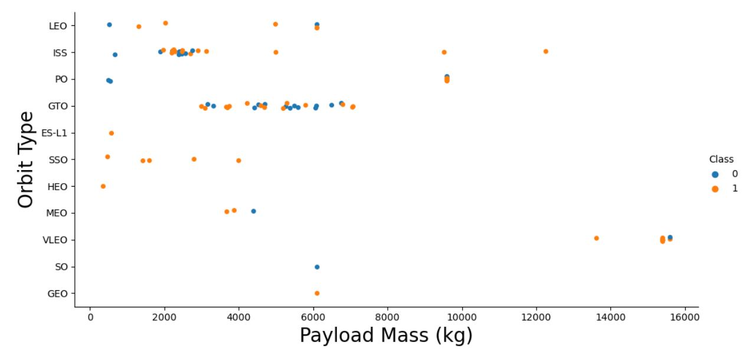
Payload vs. Orbit Type
There are strong correlation between ISS and Payload at the range around 2000, as well as GTO AND THE RANGE OF 4000-8000

Slide 23
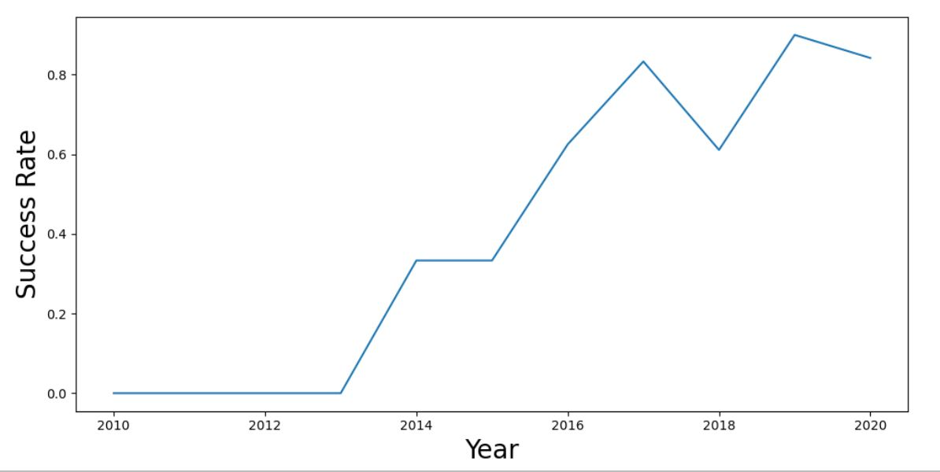
Launch Success Yearly Trend
Launch success rate has increased significantly since 2013 and has stabilized since 2019, potentially due to advance in technology and lessons learned

Slide 24
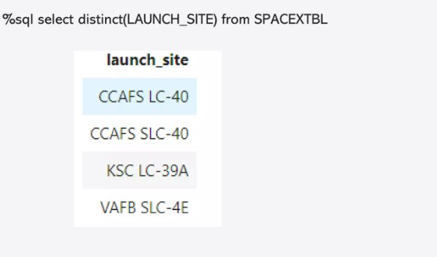
All Launch Site Names

Slide 25
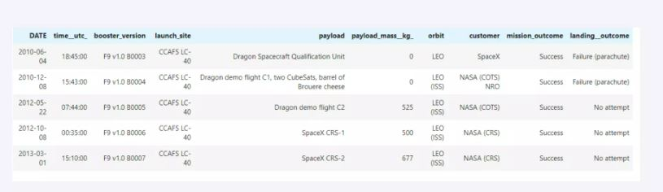
Launch Site Names Begin with 'CCA'
%sql select * from SPACEXTBL where LAUNCH_SITE like ‘CCA%’ LIMIT 5

Slide 26
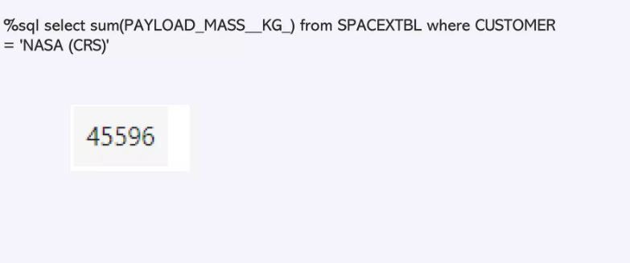
Total Payload Mass

Slide 27
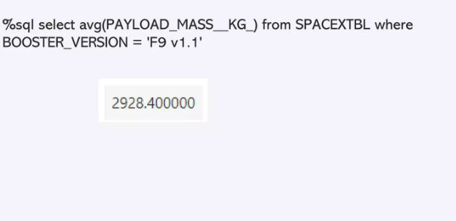
Average Payload Mass by F9 v1.1

Slide 28
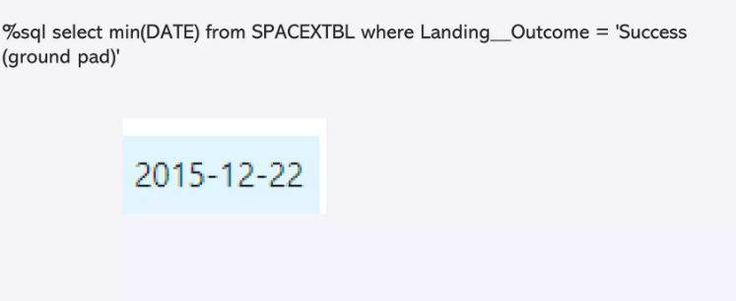
First Successful Ground Landing Date

Slide 29
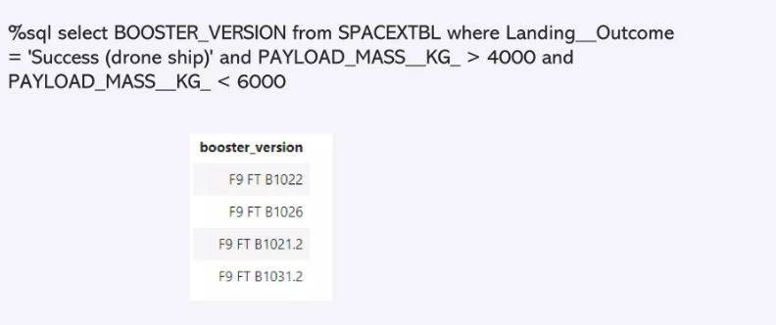
Successful Drone Ship Landing with Payload between 4000 and 6000

Slide 30
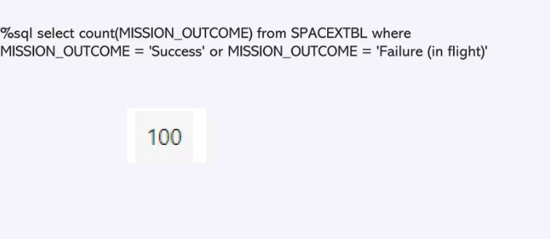
Total Number of Successful and Failure Mission Outcomes

Slide 31
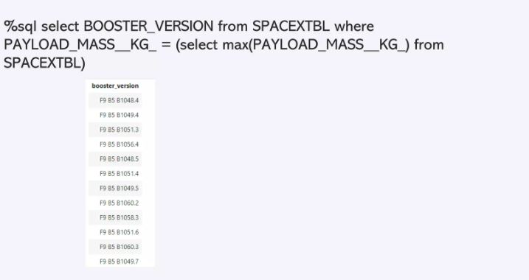
Boosters Carried Maximum Payload

Slide 32
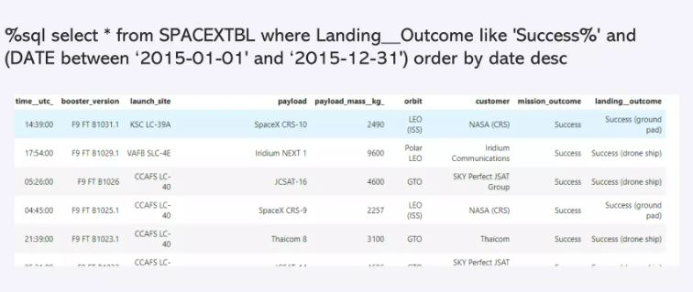
2015 Launch Records

Slide 33
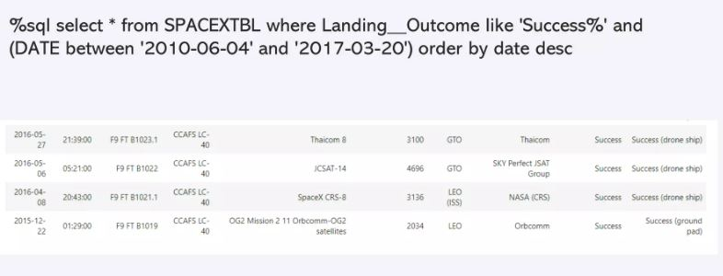
Rank Landing Outcomes Between 2010-06-04 and 2017-03-20

Slide 34

Section 3

Slide 35
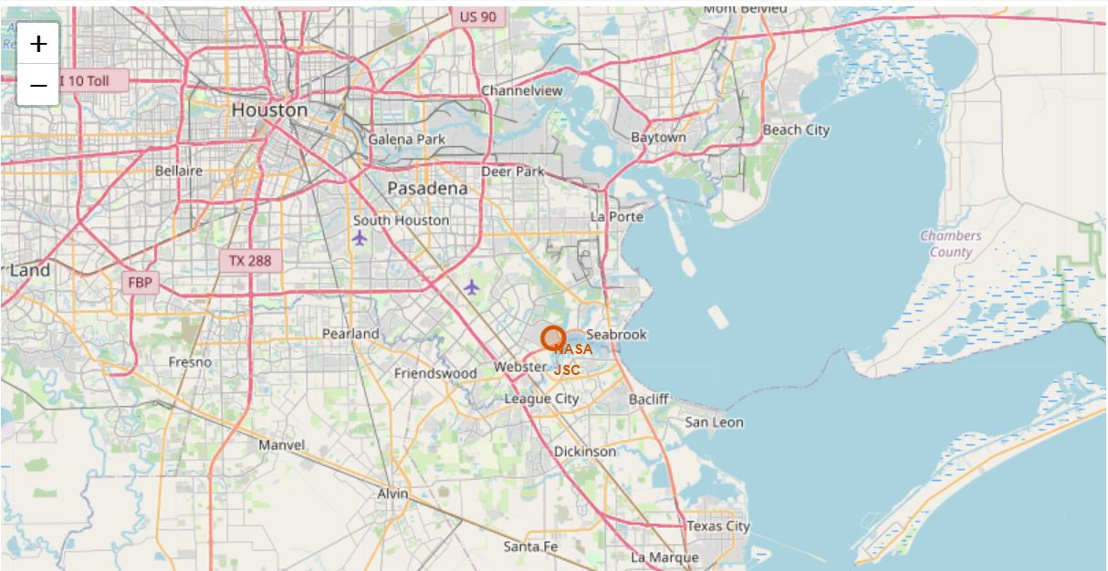
All launch sites marked on a map
An initial center location to be NASA Johnson Space Center at Houston, Texas

Slide 36
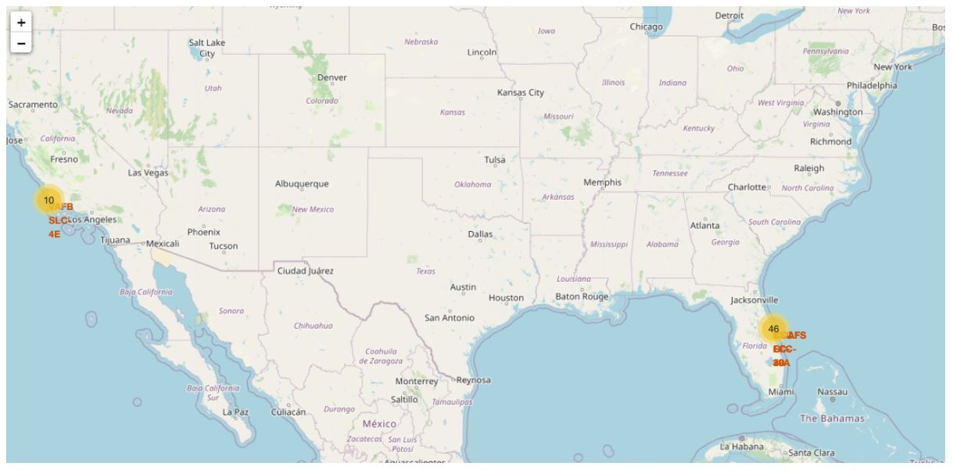
Success/failed launches marked on the map
From the color-labeled markers in marker clusters, you should be able to easily identify which launch sites have relatively high success rates.

Slide 37
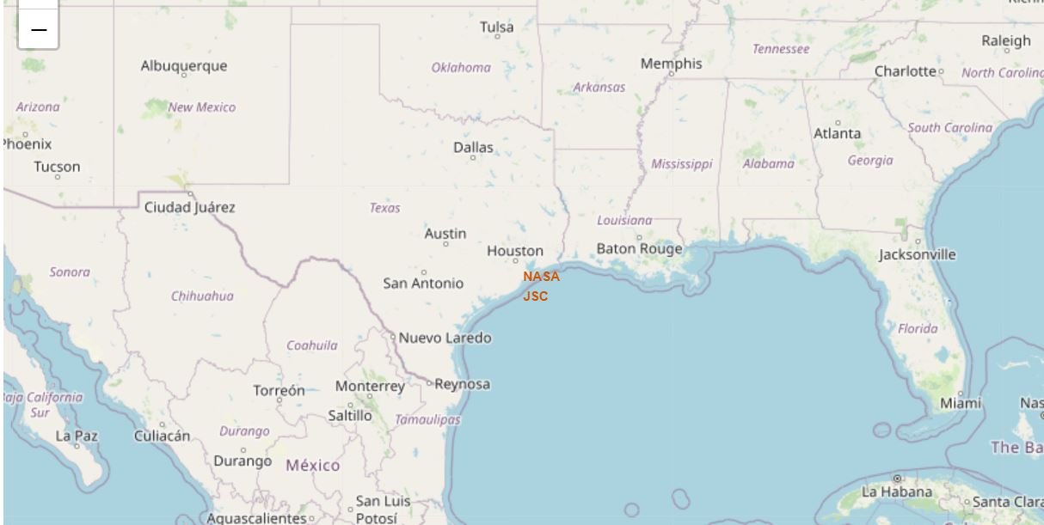
Calculate the distances between a launch site to its proximities
Explain the important elements and findings on the screenshot

Slide 38

Section 4

Slide 39
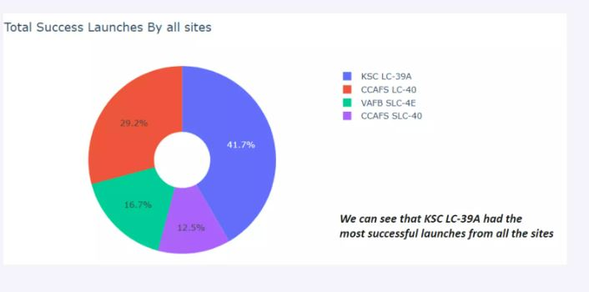
Total success launches by all sites

Slide 40
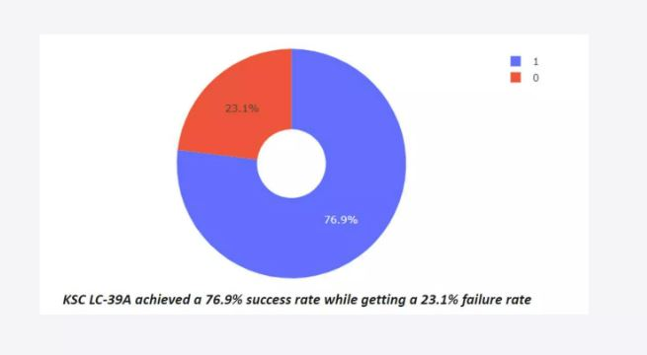
Success rate by site

Slide 41
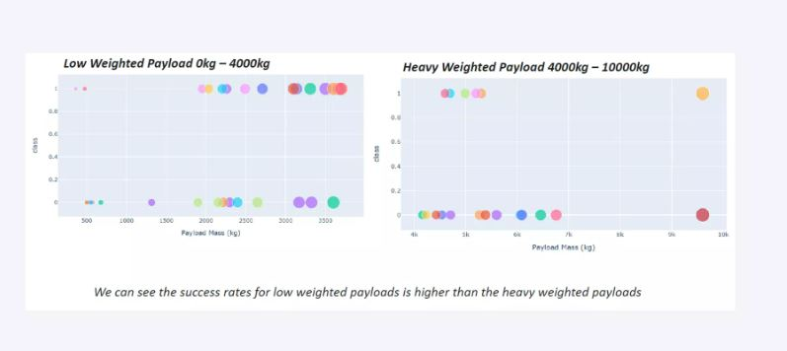
Payload vs Launch outcome

Slide 42

Section 5

Slide 43
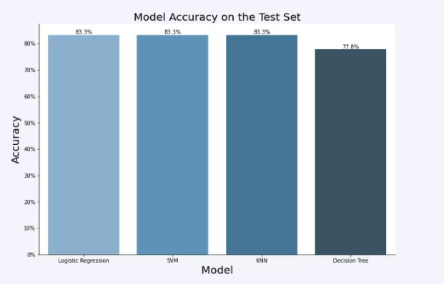
Classification Accuracy

Slide 44
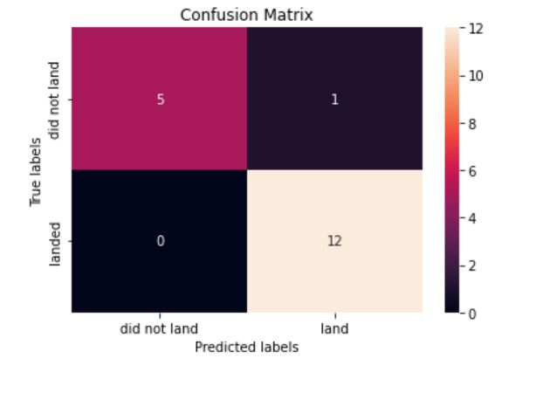
Confusion Matrix
Show the confusion matrix of the best performing model with an explanation

Slide 45

Conclusions
The course has exposed me to the world of data science
The skills Ieant can be applied to a real-world issue
The SVM, KNN, AND Logistic Regression models are the best in terms of prediction accuracy for this dataset
Orbit GEO,HEO,SSO,ES L1 has the best Success Rate

Slide 46
Appendix
Include any relevant assets like Python code snippets, SQL queries, charts, Notebook outputs, or data sets that you may have created during this project

Slide 47


